Slide 1
Network Intrusion Detection: KDD99
By: Kareem Ismail

Slide 2

My Initial Thought Process
Everyone has dealt with connection problems and will for the foreseeable future. Even the most innocent individual browsing the internet for their refrigerator magnet collection is under the risk of losing their personal private information which could very well lead to mortgages and bankruptcy.
My research aims to distinguish between proper, secure connections and bad, dangerous connections by identifying suspicious activities; aka intrusions.

Slide 3

And so…
I decided to implement this project using the KDD99 Dataset (created in 1998), with the help of this vastly huge dataset I will be able to identify attack risks that the users could suffer.
What it provided for me:
Classification-type dataset.
Assembled from 2 weeks worth of normal instances and 5 weeks of attack instances.
80% of the dataset contained attack instances. (approx. 392,000)
41 attributes.

Slide 4
Experimenting Phase
Algorithms used
Evaluation metrics
Logistic Regression
Support Vector Machines (SVM)
Decision Trees
Random Forests
Precision
Recall
F1 Score

Slide 5
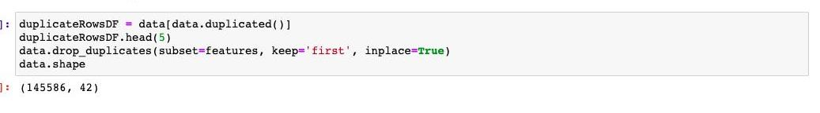
Data Cleaning
After importing all the necessary libraries and the dataset, I started processing the data
I removed all the duplicates and null values that might effect our predictions.

Slide 6
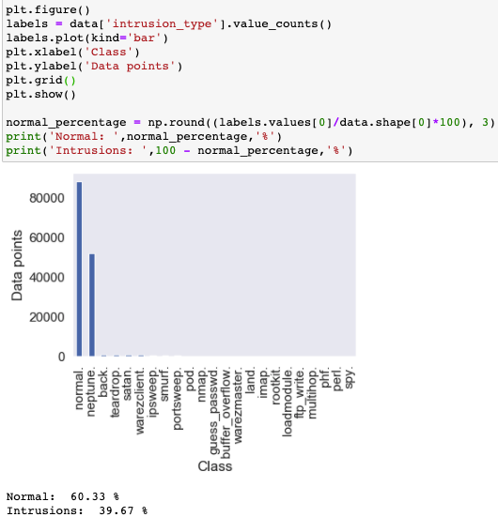
Data Analysis
Normal: 60.33%
Intrusions: 39.67%

Slide 7
Data Split
Training: 75%
Testing: 25%

Slide 8
One-hot encoding
Categorical features
Service
Flag
Protocol

Slide 9
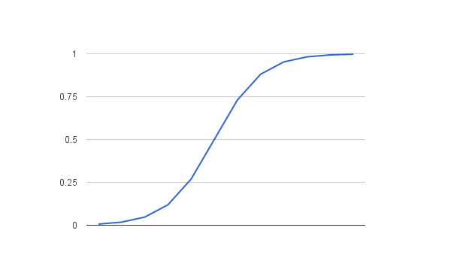
Logistic Regression

Slide 10
Logistic Regression (without Regularization)
Training Time: 34 seconds.
Testing Time: 0.01 seconds.
Precision Score: 0.921
Recall Score: 0.953
F1-Score: 0.933

Slide 11
Logistic Regression (with Regularization)
Training Time: 34 min & 38 sec
Testing Time: 0.02 seconds.
Best parameters:
Alpha: 20
Penalty: L1
Training TPR/FPR Results:
TP: 63924
FP: 2425
TPR: 0.97
FPR: 0.56
Testing TPR/FPR Results:
TP: 21323
FP: 856
TPR: 0.97
FPR: 0.59
Training Results:
Precision Score: 0.907
Recall Score: 0.941
F1-Score: 0.924
Test Results:
Precision Score: 0.907
Recall Score: 0.941
F1-Score: 0.924

Slide 12
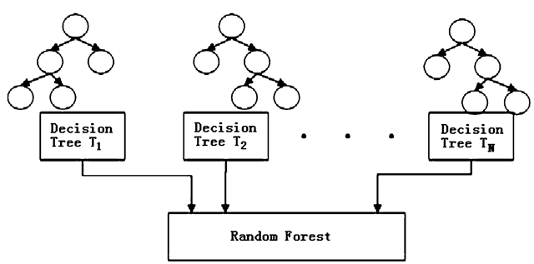
Random Forest

Slide 13
Random Forest (without Feature Scaling)
Training Time: 11 min & 27 sec
Testing Time: 32 seconds.
Best parameters:
Max depth: 500
Minimum samples split: 5
Training TPR/FPR Results:
TP: 65870
FP: 0
TPR: 0.999
FPR: 0
Testing TPR/FPR Results:
TP: 21947
FP: 30
TPR: 0.999
FPR: 0.2
Training Results:
Precision Score: 0.999
Recall Score: 0.999
F1-Score: 0.999
Test Results:
Precision Score: 0.998
Recall Score: 0.998
F1-Score: 0.998

Slide 14
Feature Scaling (via Standardization)
Reason:
To scale features of the dataset
How it works:
By centering the feature columns at mean 0, with std. deviation 1
(Same parameters as standard normal distribution)

Slide 15
Logistic Regression (with Regularization & Feature Scaling)
Training Time: 3 min & 45 sec
Testing Time: 0.01 seconds.
Best parameters:
Alpha: 0.001
Penalty: L2
Training TPR/FPR Results:
TP: 65766
FP: 1513
TPR: 0.998
FPR: 0.035
Testing TPR/FPR Results:
TP: 21917
FP: 530
TPR: 0.998
FPR: 0.037
Training Results:
Precision Score: 0.983
Recall Score: 0.984
F1-Score: 0.978
Test Results:
Precision Score: 0.982
Recall Score: 0.983
F1-Score: 0.979

Slide 16
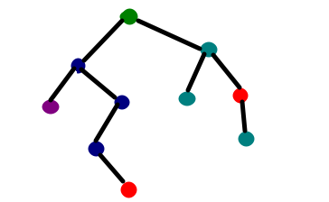
Decision Tree

Slide 17
Decision Tree (with Feature Scaling)
Training Time: 43 seconds.
Testing Time: 0.01 seconds.
Best parameters:
Max depth: 500
Minimum samples split: 5
Training TPR/FPR Results:
TP: 65875
FP: 0
TPR: 0.999
FPR: 0
Testing TPR/FPR Results:
TP: 21934
FP: 11
TPR: 0.999
FPR: 0.0007
Training Results:
Precision Score: 0.999
Recall Score: 0.999
F1-Score: 0.999
Test Results:
Precision Score: 0.998
Recall Score: 0.998
F1-Score: 0.998

Slide 18
Random Forest (with Feature Scaling)
Training Time: 20 min & 48 sec
Testing Time: 0.63 second
Best parameters:
Max depth: 500
Minimum samples split: 10
N estimators: 100
Training TPR/FPR Results:
TP: 65870
FP: 0
TPR: 0.999
FPR: 0
Testing TPR/FPR Results:
TP: 21945
FP: 20
TPR: 0.999
FPR: 0.2
Training Results:
Precision Score: 0.999
Recall Score: 0.999
F1-Score: 0.999
Test Results:
Precision Score: 0.998
Recall Score: 0.999
F1-Score: 0.999

Slide 19
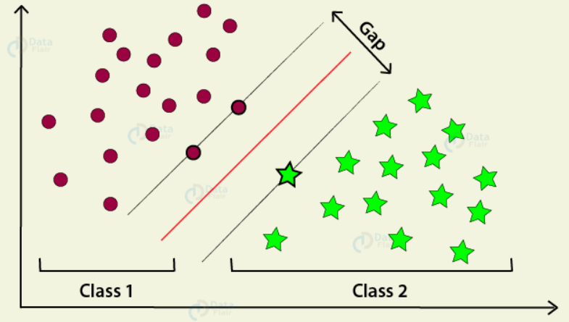
Support Vector Machines

Slide 20
SVM (with Feature Scaling)
Training Time: 7 min & 11 sec
Testing Time: 0.01 seconds.
Best parameters:
Alpha: 1e-06
Penalty: L1
Training TPR/FPR Results:
TP: 65776
FP: 198
TPR: 0.998
FPR: 0.46
Testing TPR/FPR Results:
TP: 21905
FP: 76
TPR: 0.998
FPR: 0.53
Training Results:
Precision Score: 0.996
Recall Score: 0.996
F1-Score: 0.996
Test Results:
Precision Score: 0.995
Recall Score: 0.995
F1-Score: 0.995

Slide 21

As we can see..
Comparing the values of each algorithm side by side; I saw that the decision tree algorithm bests its competitors with the lowest FPR score of 0.0007.

Slide 22
Thank You Stranger.

